Slide 1
2023 RTEP Report
Key Maps, Tables & Figures
The following set of slides provides key information from PJM’s 2023 RTEP cycle. The slides are provided for the reader’s own communications needs.

Slide 2
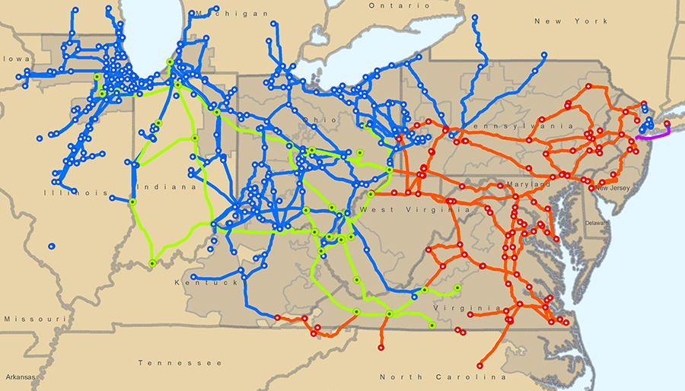
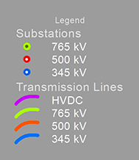
PJM Backbone Transmission System

Slide 3
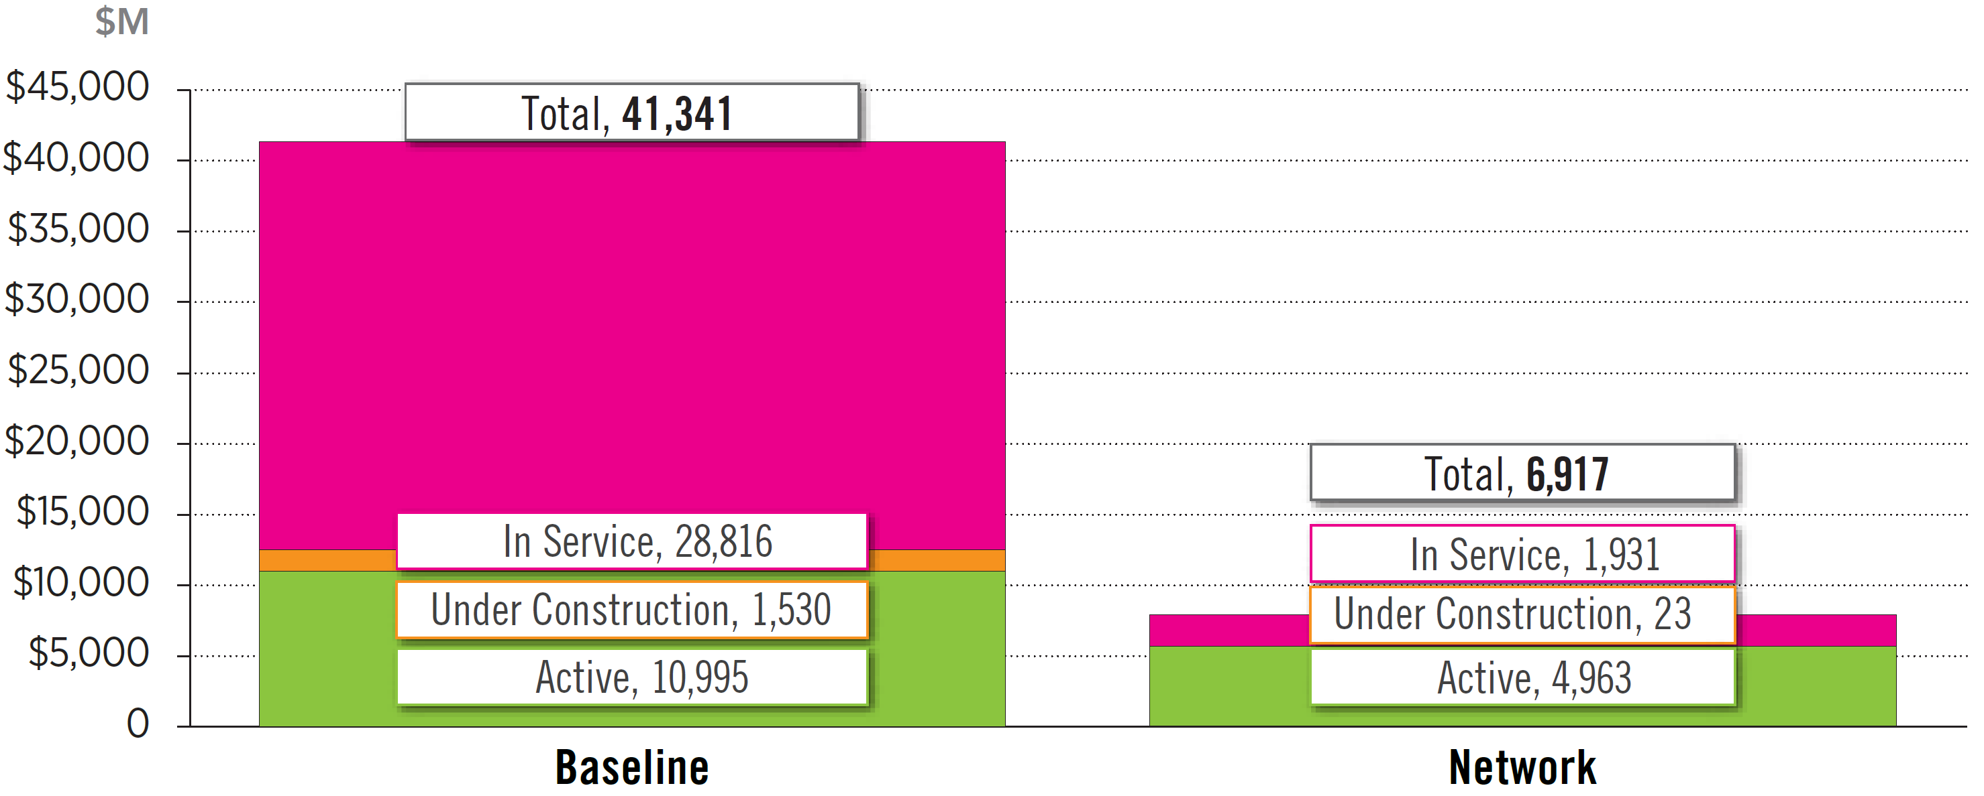
Board-Approved RTEP Projects
(as of Dec. 31, 2023)
Notes:
Herman 3/1/2023

Slide 4
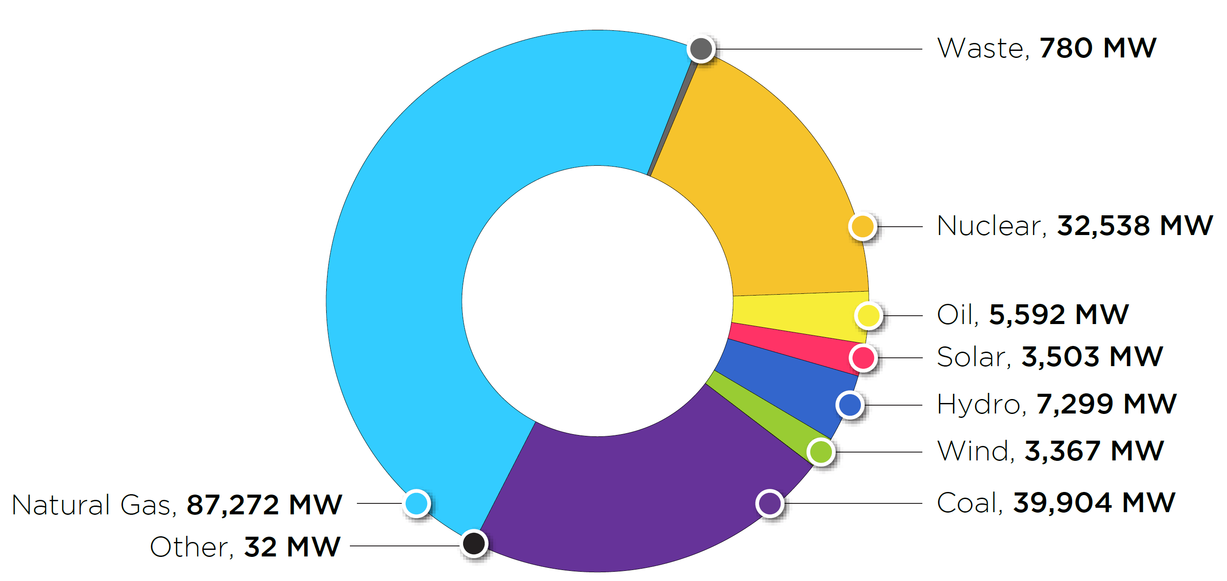
PJM Existing RPM-Eligible Installed Capacity Mix
As of Dec. 31, 2023
Notes:
Herman – updated Feb. 2023

Slide 5
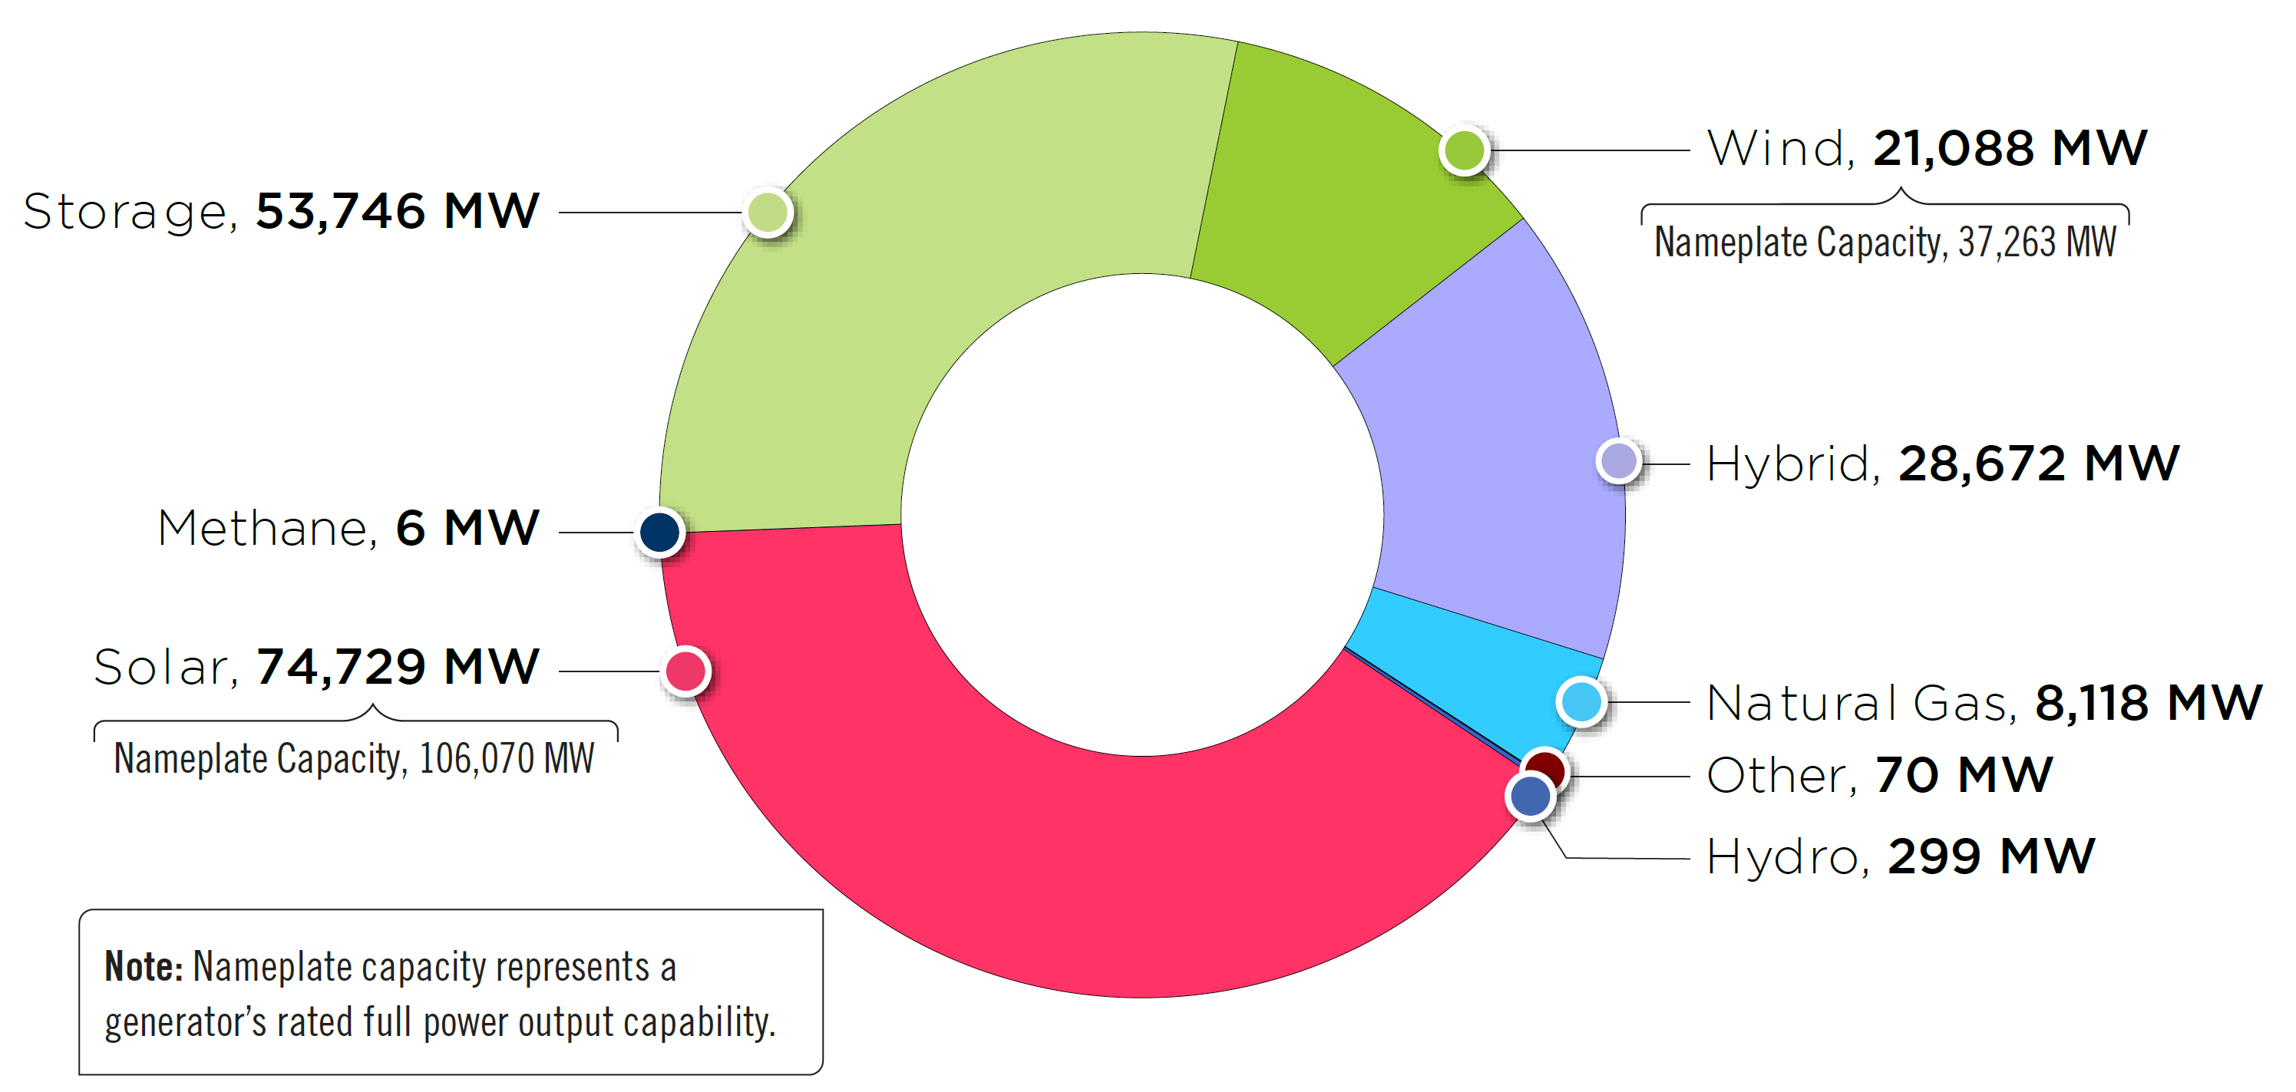
Interconnection Service Request Generation
Fuel Mix – Requested Capacity Interconnection Rights
As of Dec. 31, 2023
Notes:
Herman – updated Feb. 2023

Slide 6
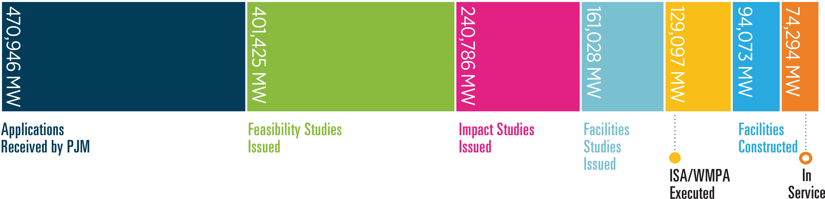
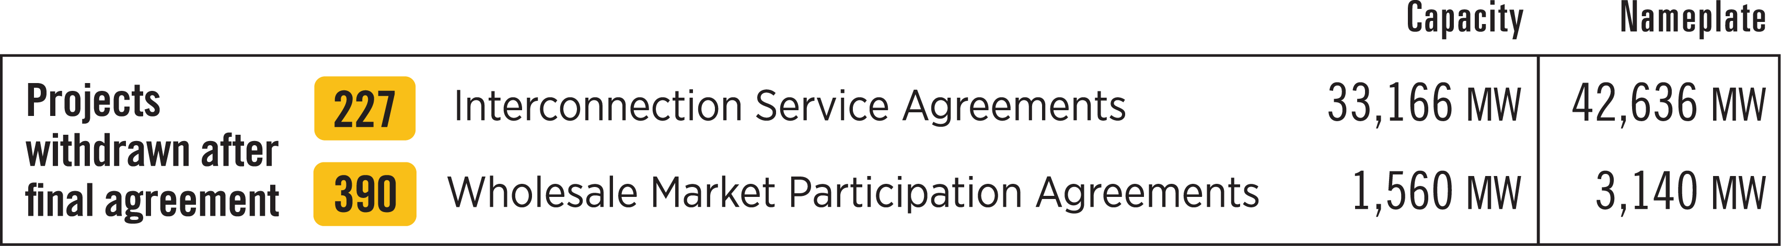
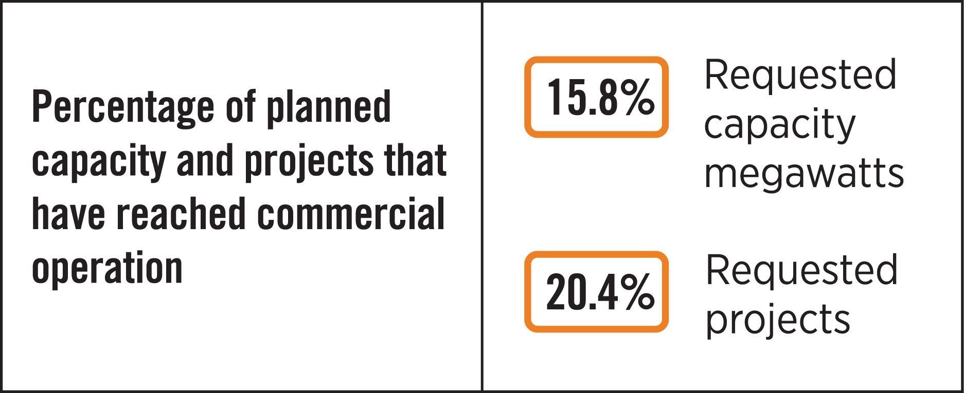
Interconnection Service Study Requests
(Dec. 31, 2023)
This figure shows, historically, how far generation requests had proceeded in the interconnection process before they exited active participation (i.e., before they reached in-service status, began construction, were suspended or withdrew). The graphic does not include projects considered active in the queue as of Dec. 31, 2023.
Notes:
Feb. 22, 2022 herman

Slide 7
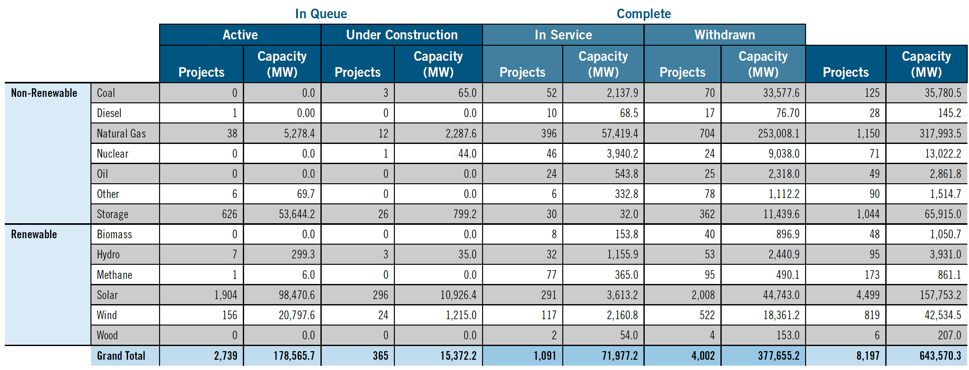
Requested Capacity Interconnection Rights,
Non-Renewable and Renewable Fuels (Dec. 31, 2023)
Note: Table does not include suspended projects, and hybrid resources are imbedded within the fuel type
(e.g., solar + storage is captured under “Solar,” wind + storage is captured under “Wind,” and natural gas also includes some hybrid resources)

Slide 8
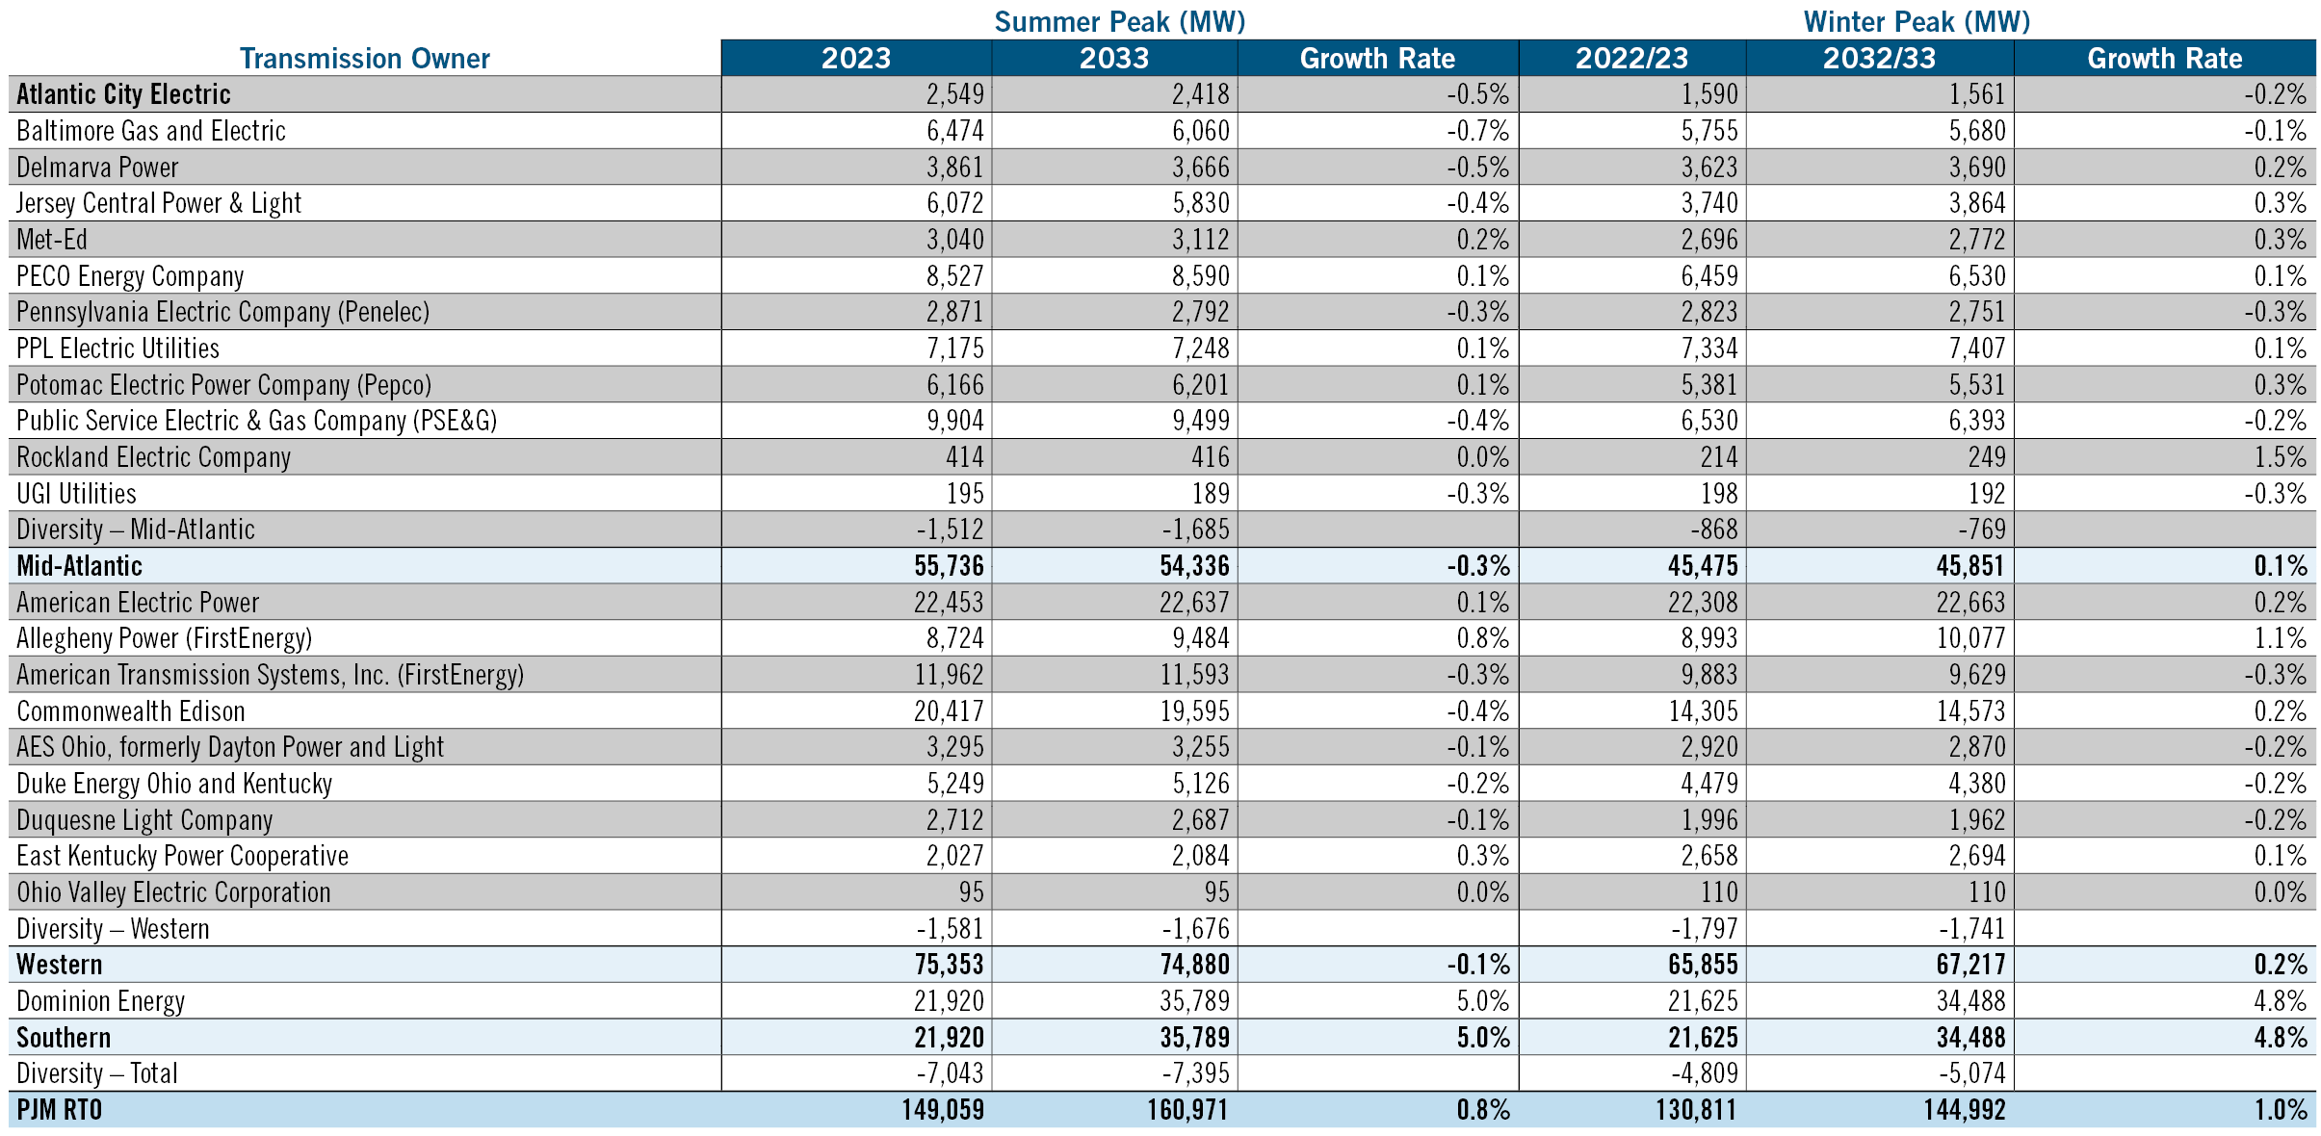
2023 Load Forecast Report

Slide 9
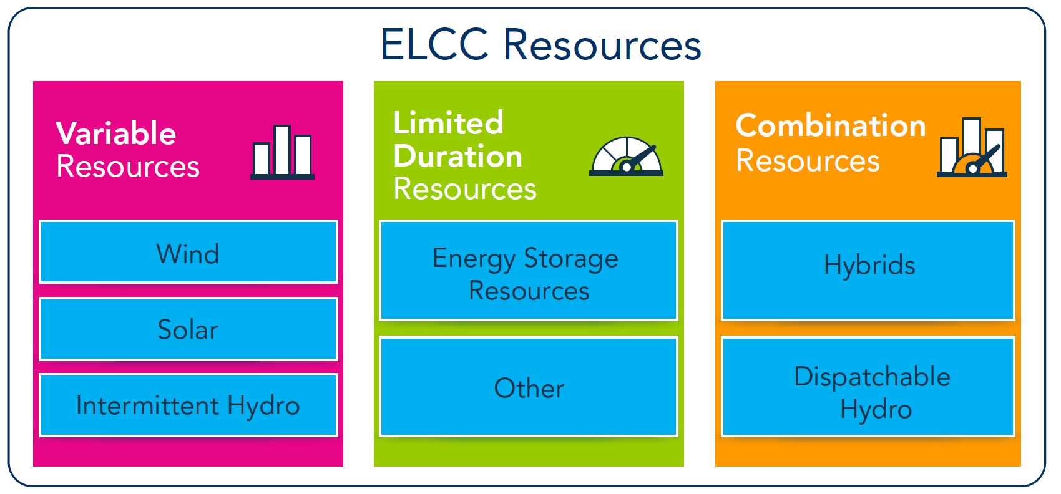
ELCC Resources

Slide 10
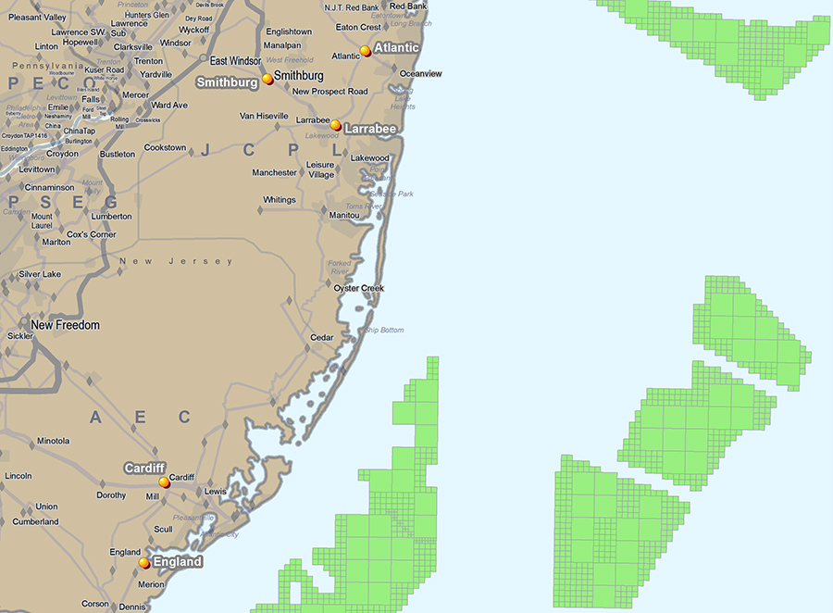
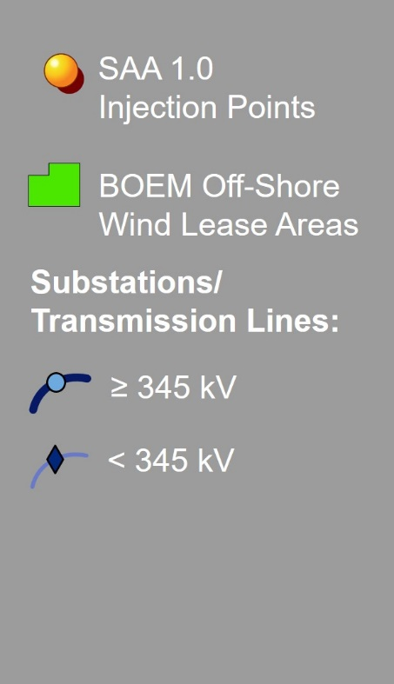

NJBPU Project SAA 1.0 Injection Points

Slide 11
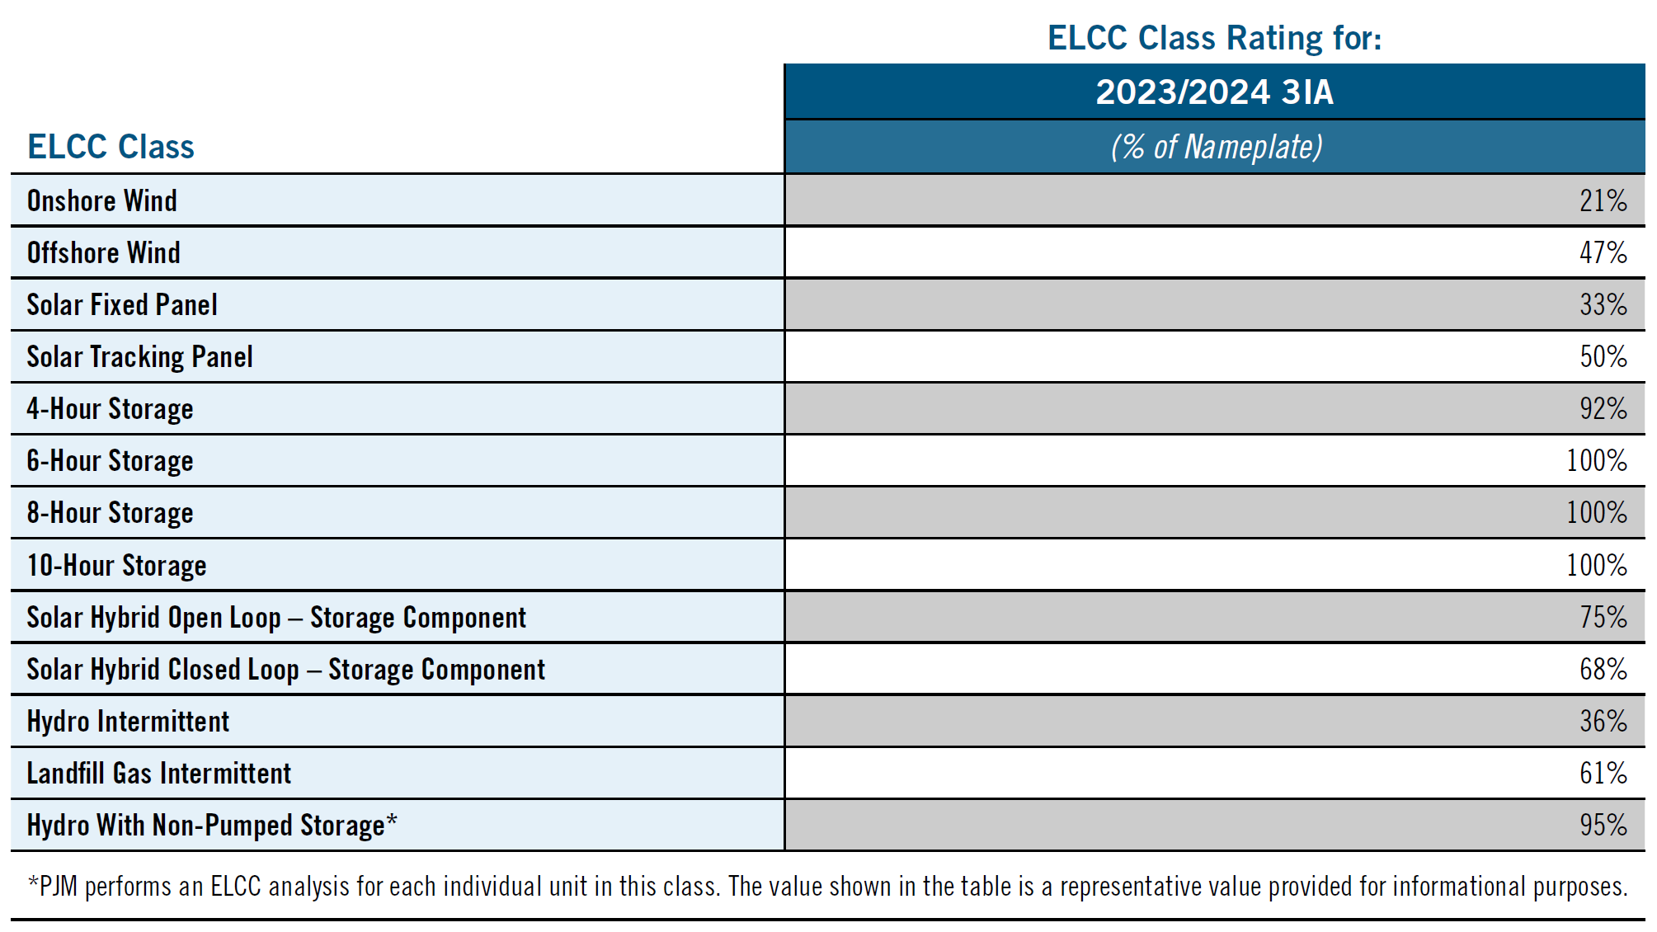
ELCC Class Ratings for 2024/2025 3IA

Slide 12
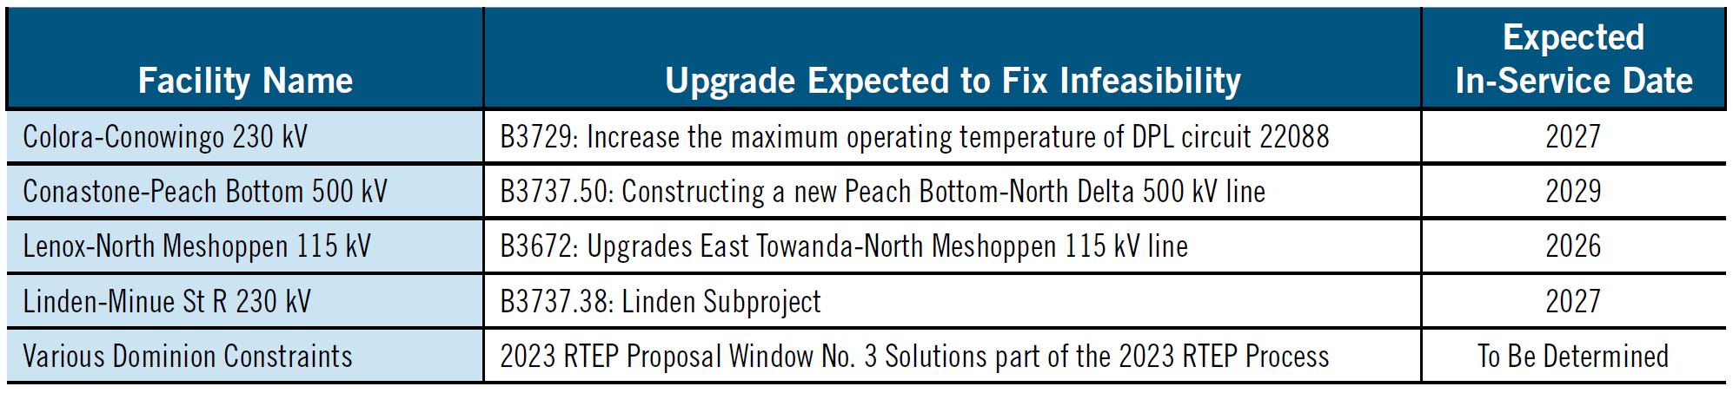
2023/2024 Stage 1A ARR 10-Year Feasibility Study:
Reliability Criteria Violations

Slide 13
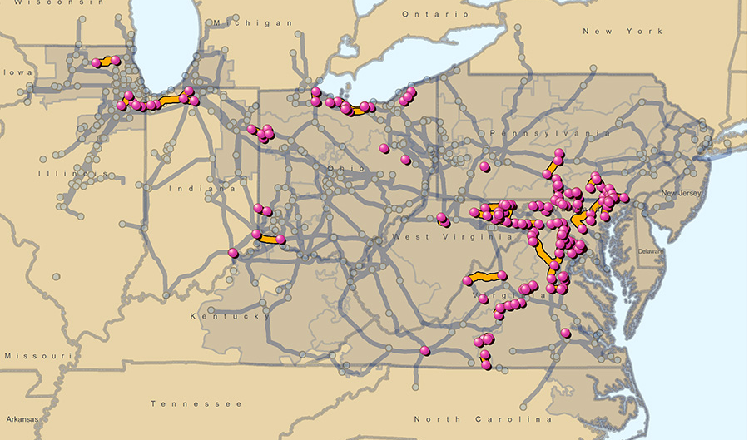
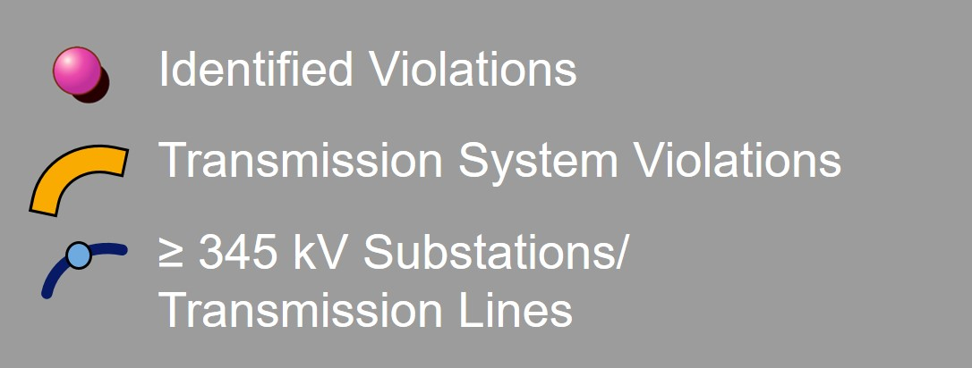
2023 RTEP Baseline Thermal and Voltage Criteria Violations

Slide 14
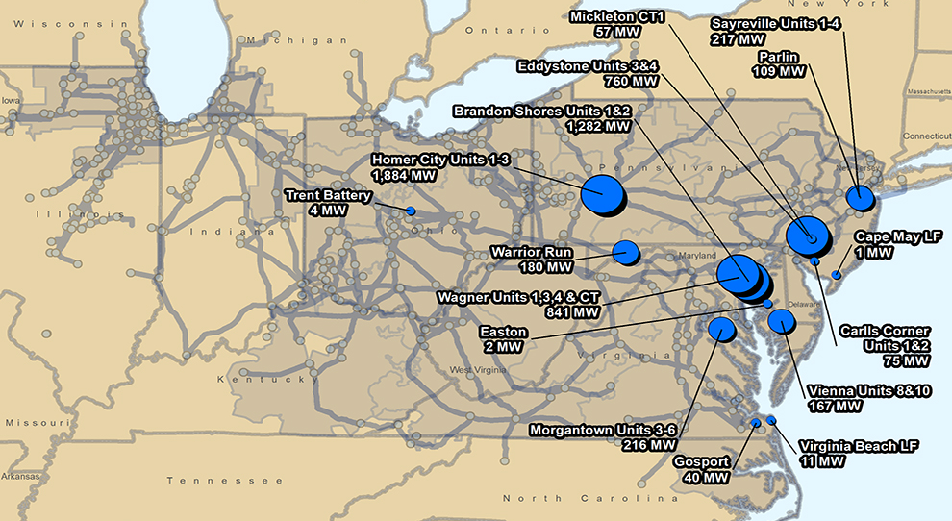
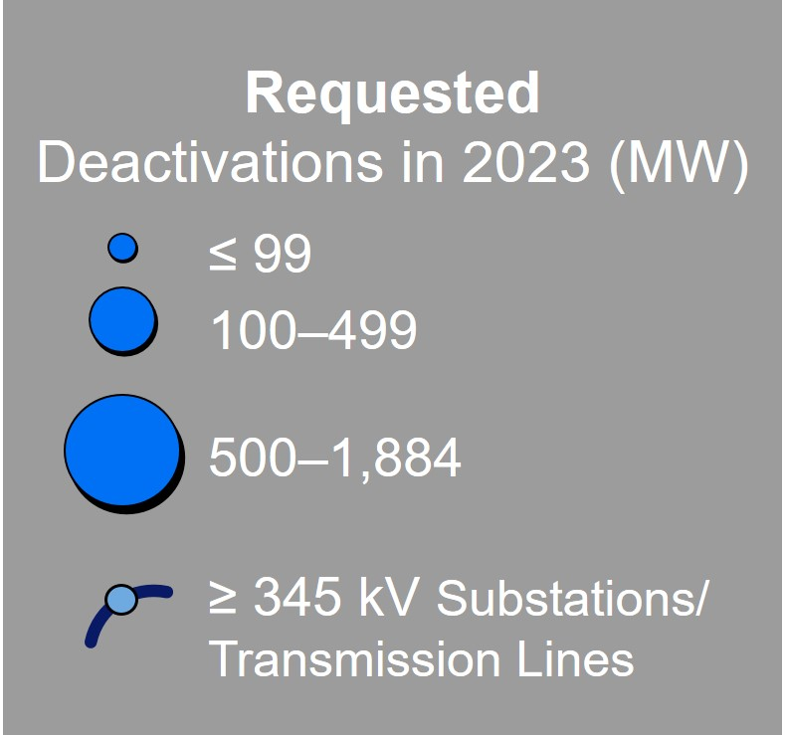
Deactivation Notifications Received in 2023

Slide 15
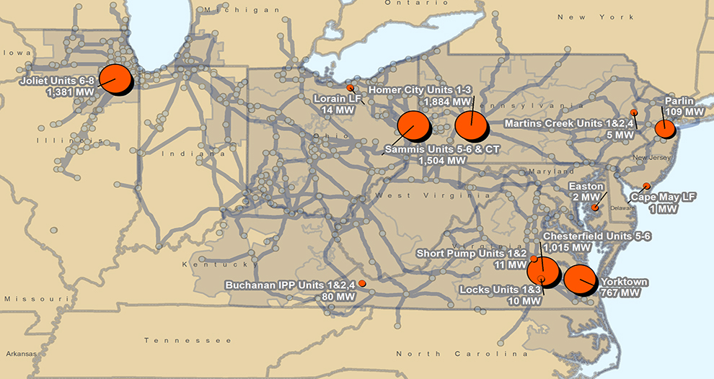
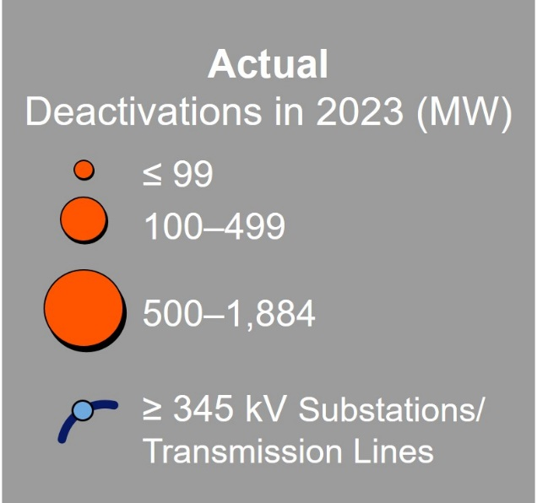
Actual Generator Deactivations in 2023

Slide 16
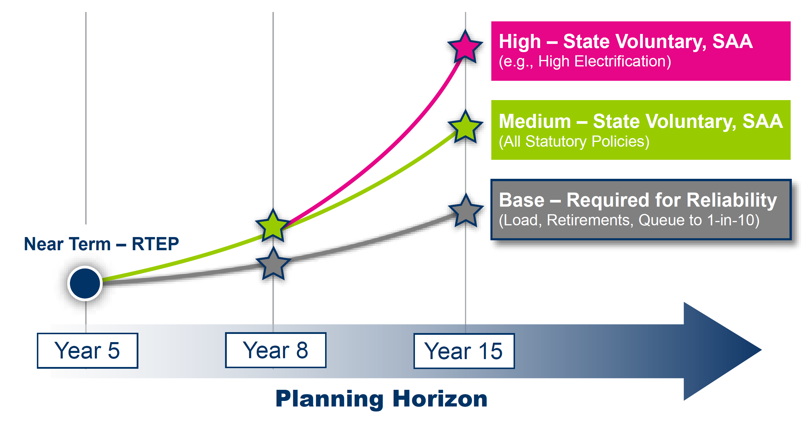
Implementing LTRTP Into Existing PJM RTEP Process

Slide 17
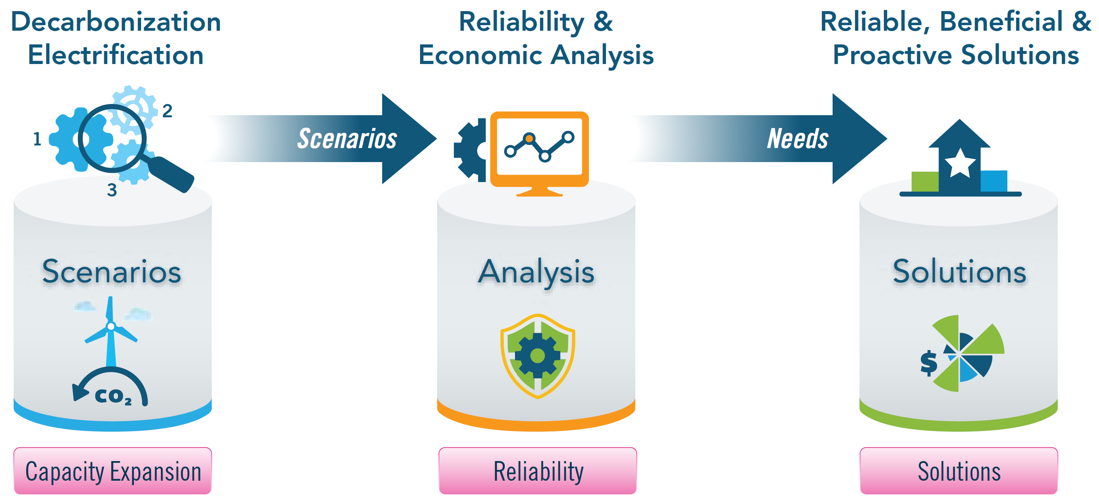
Long-Term Regional Transmission Planning Framework

Slide 18
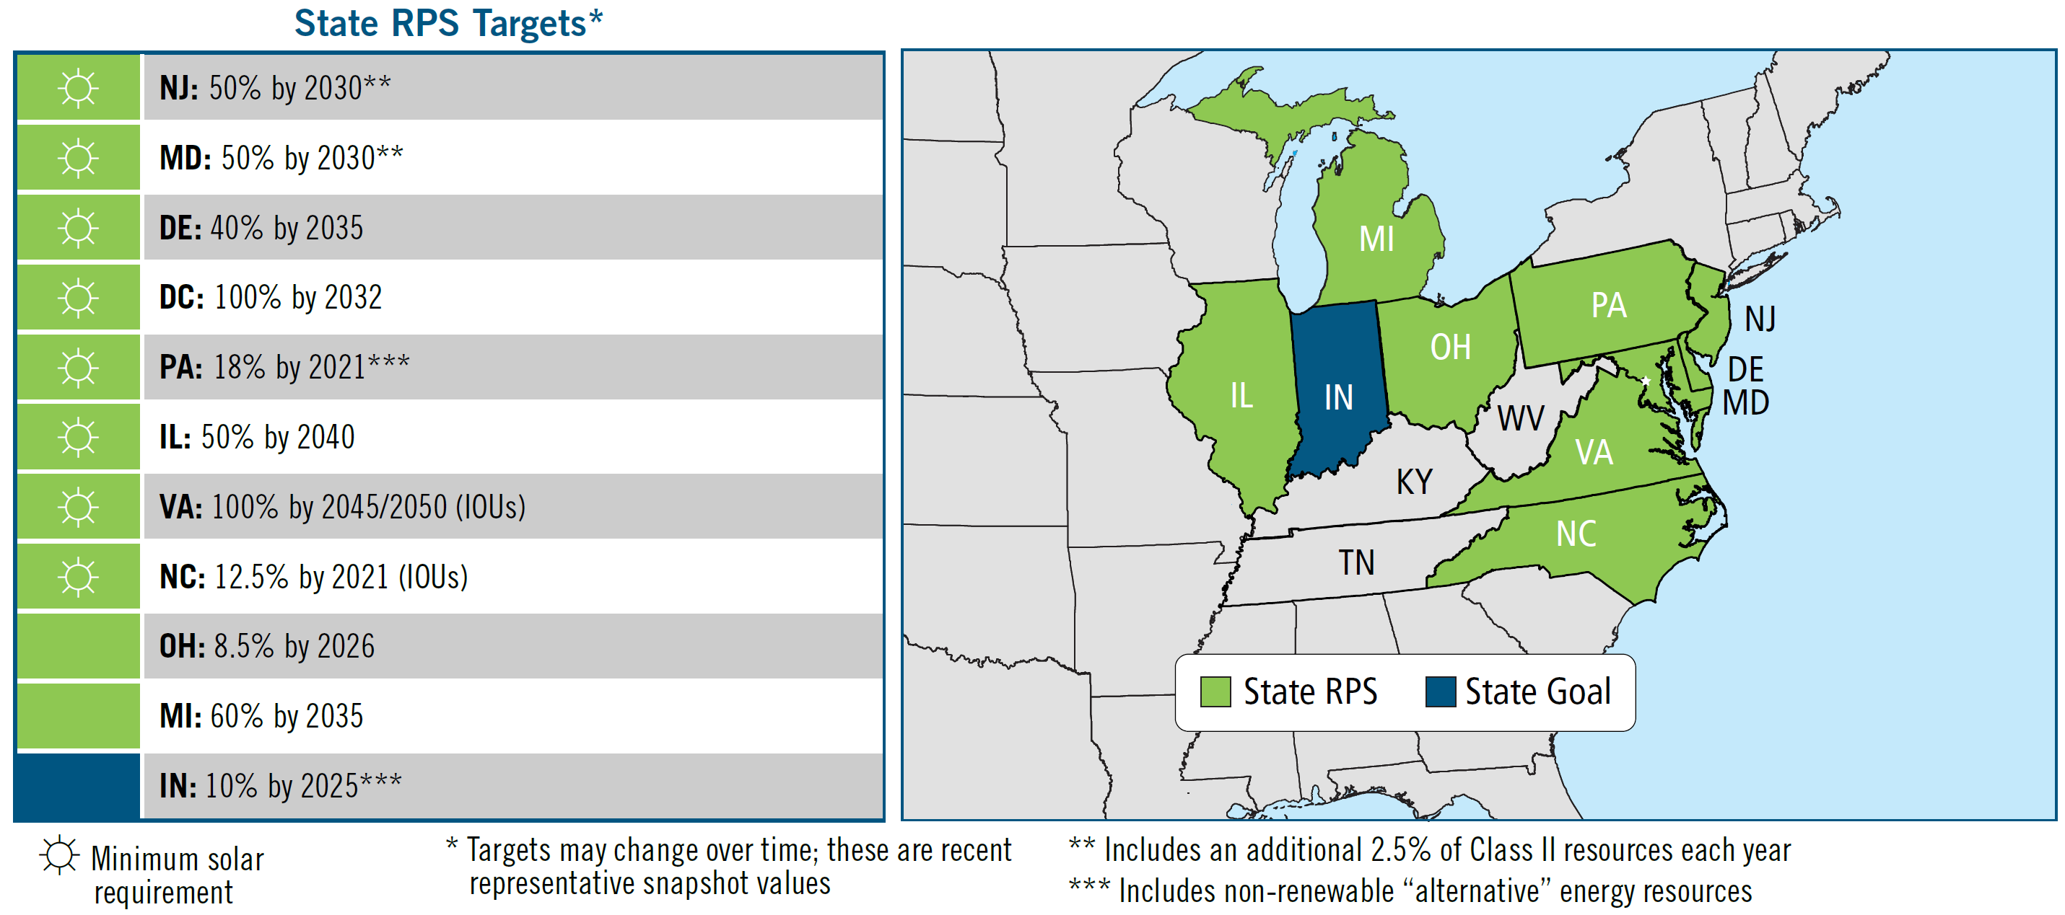
PJM State RPS Targets and Goals
(as of January 2024)

Slide 19
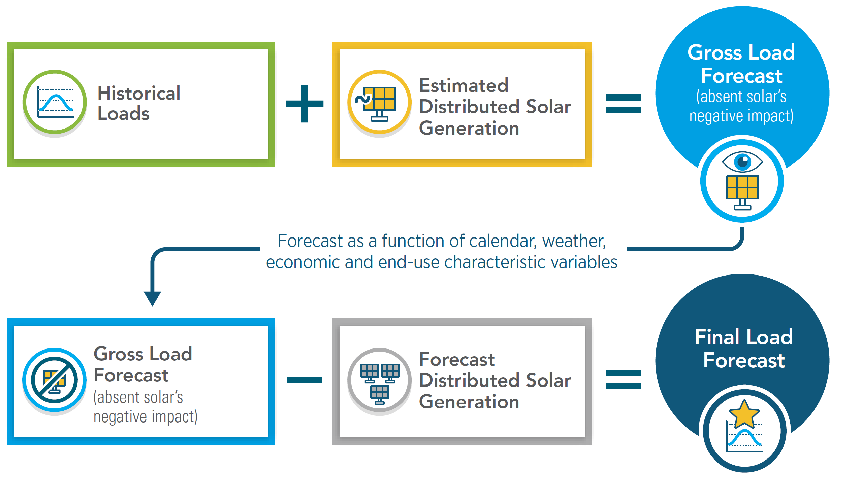
Accounting for Distributed Solar Generation

Slide 20
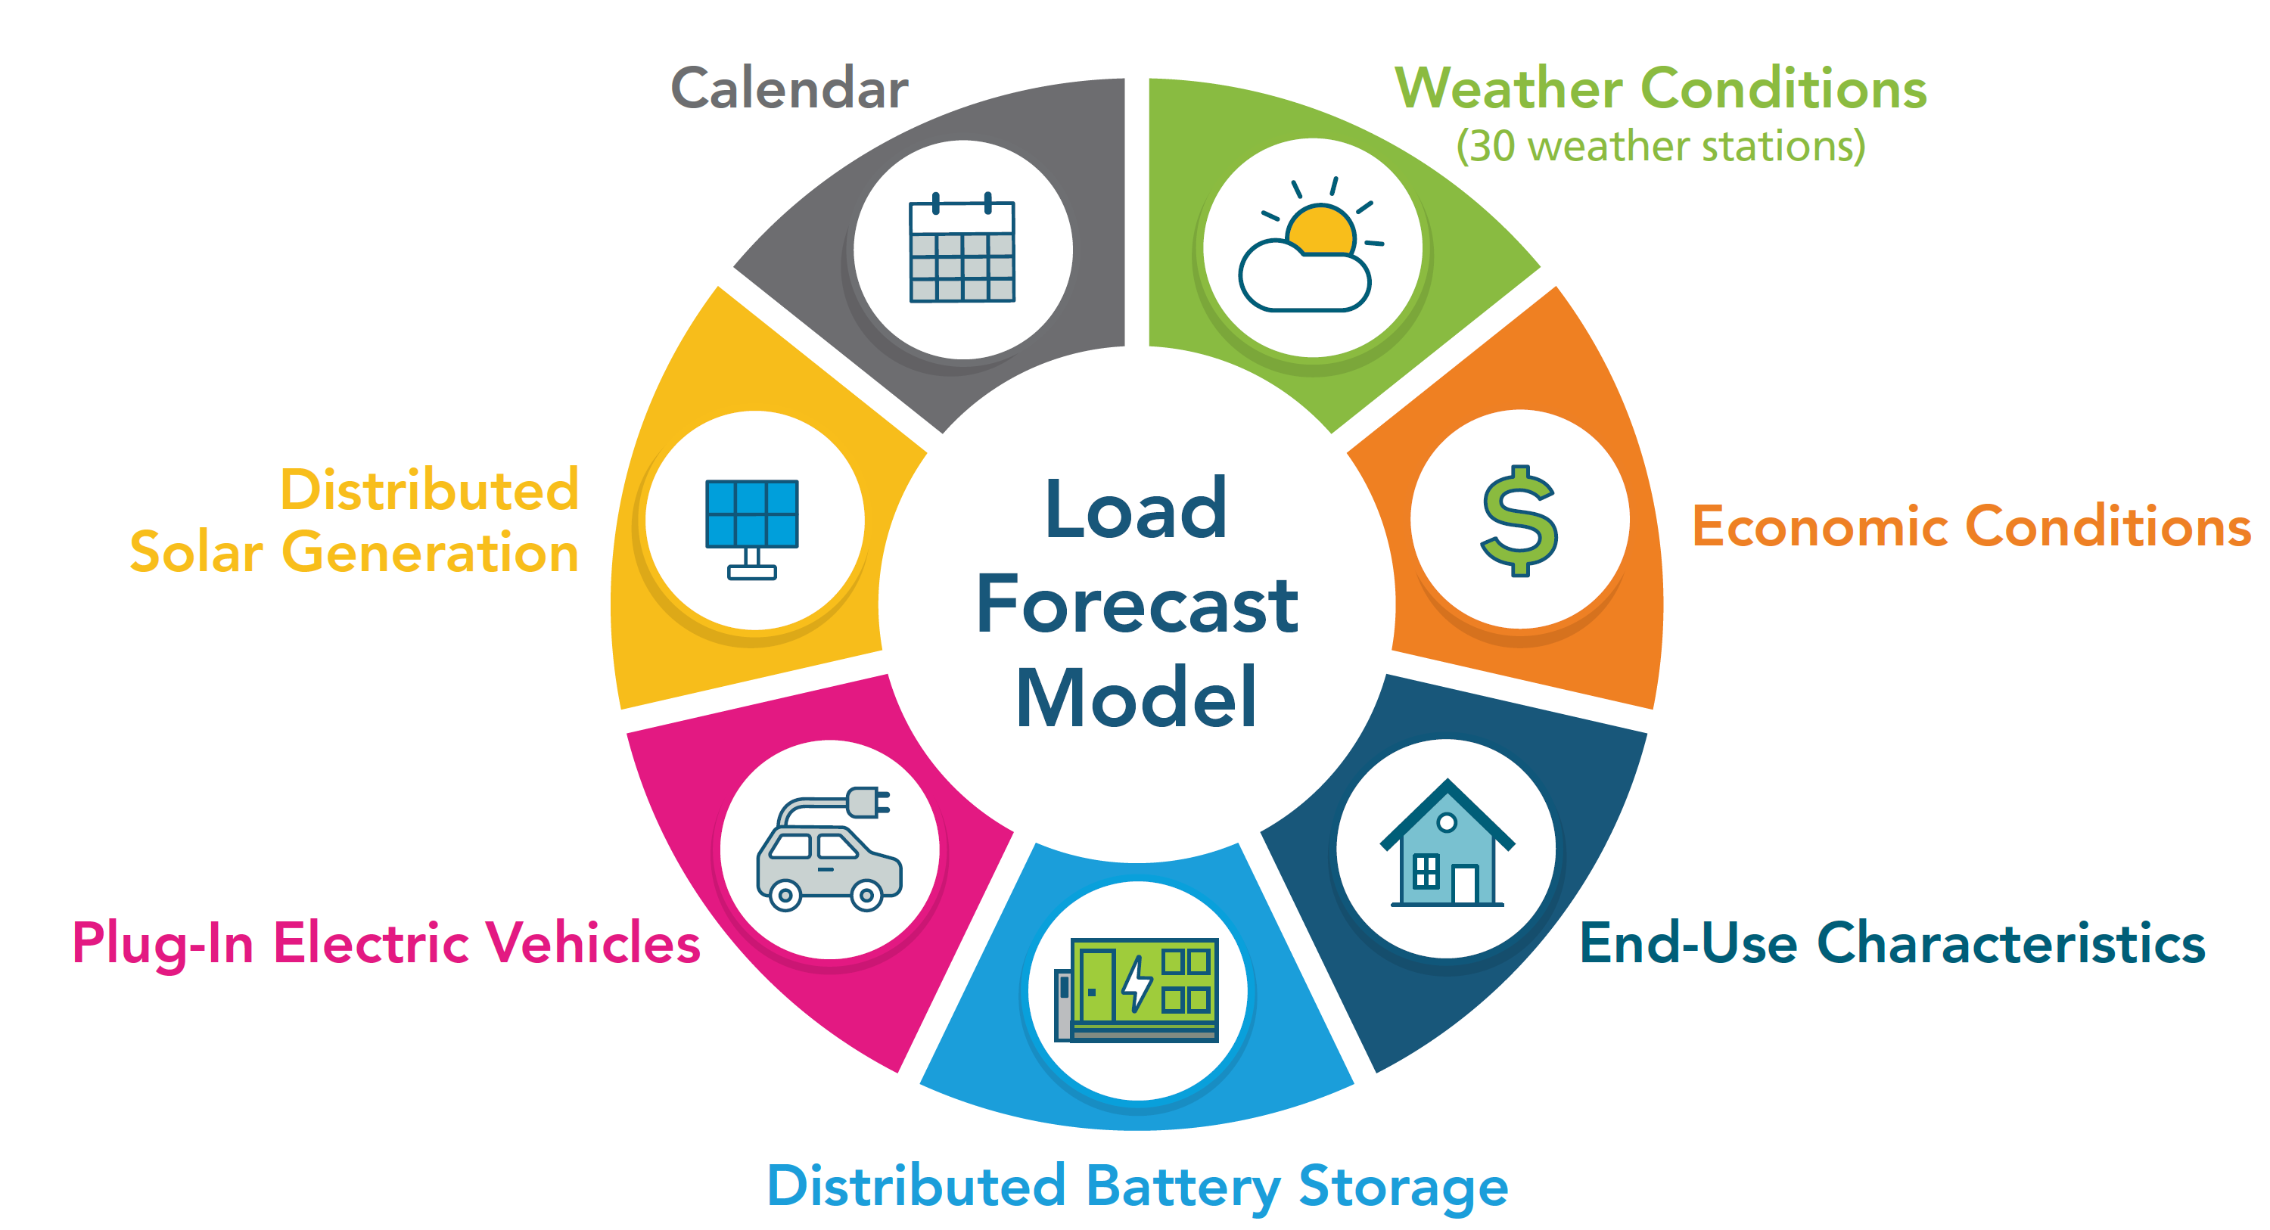
Load Forecast Model

Slide 21
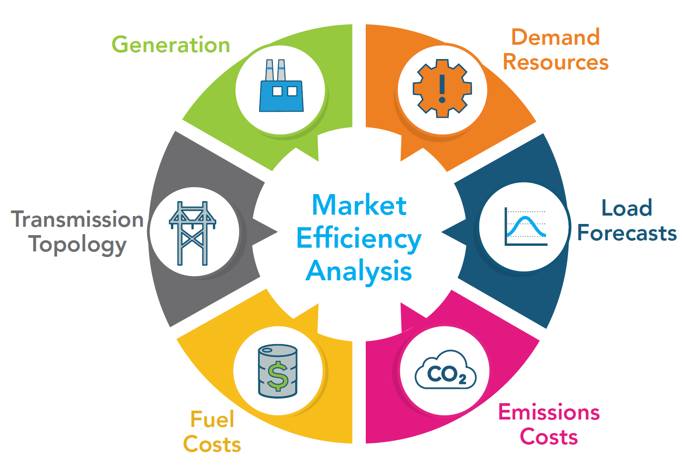
Market Efficiency Analysis Parameters

Slide 22
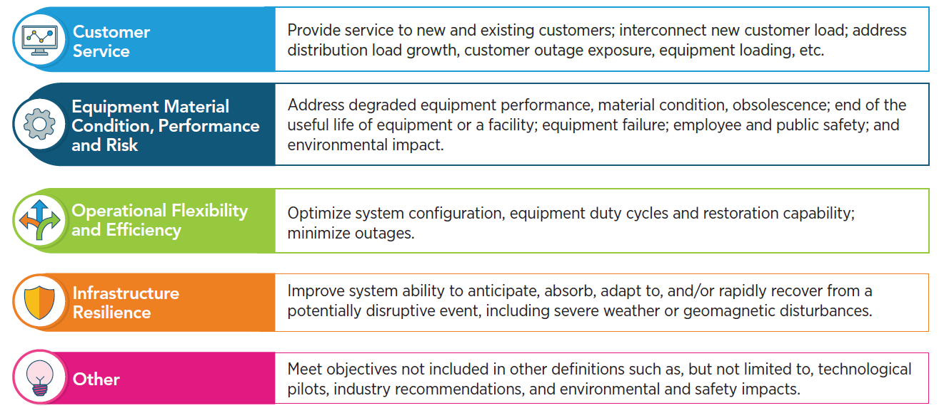
Primary Supplemental Project Drivers

Slide 23
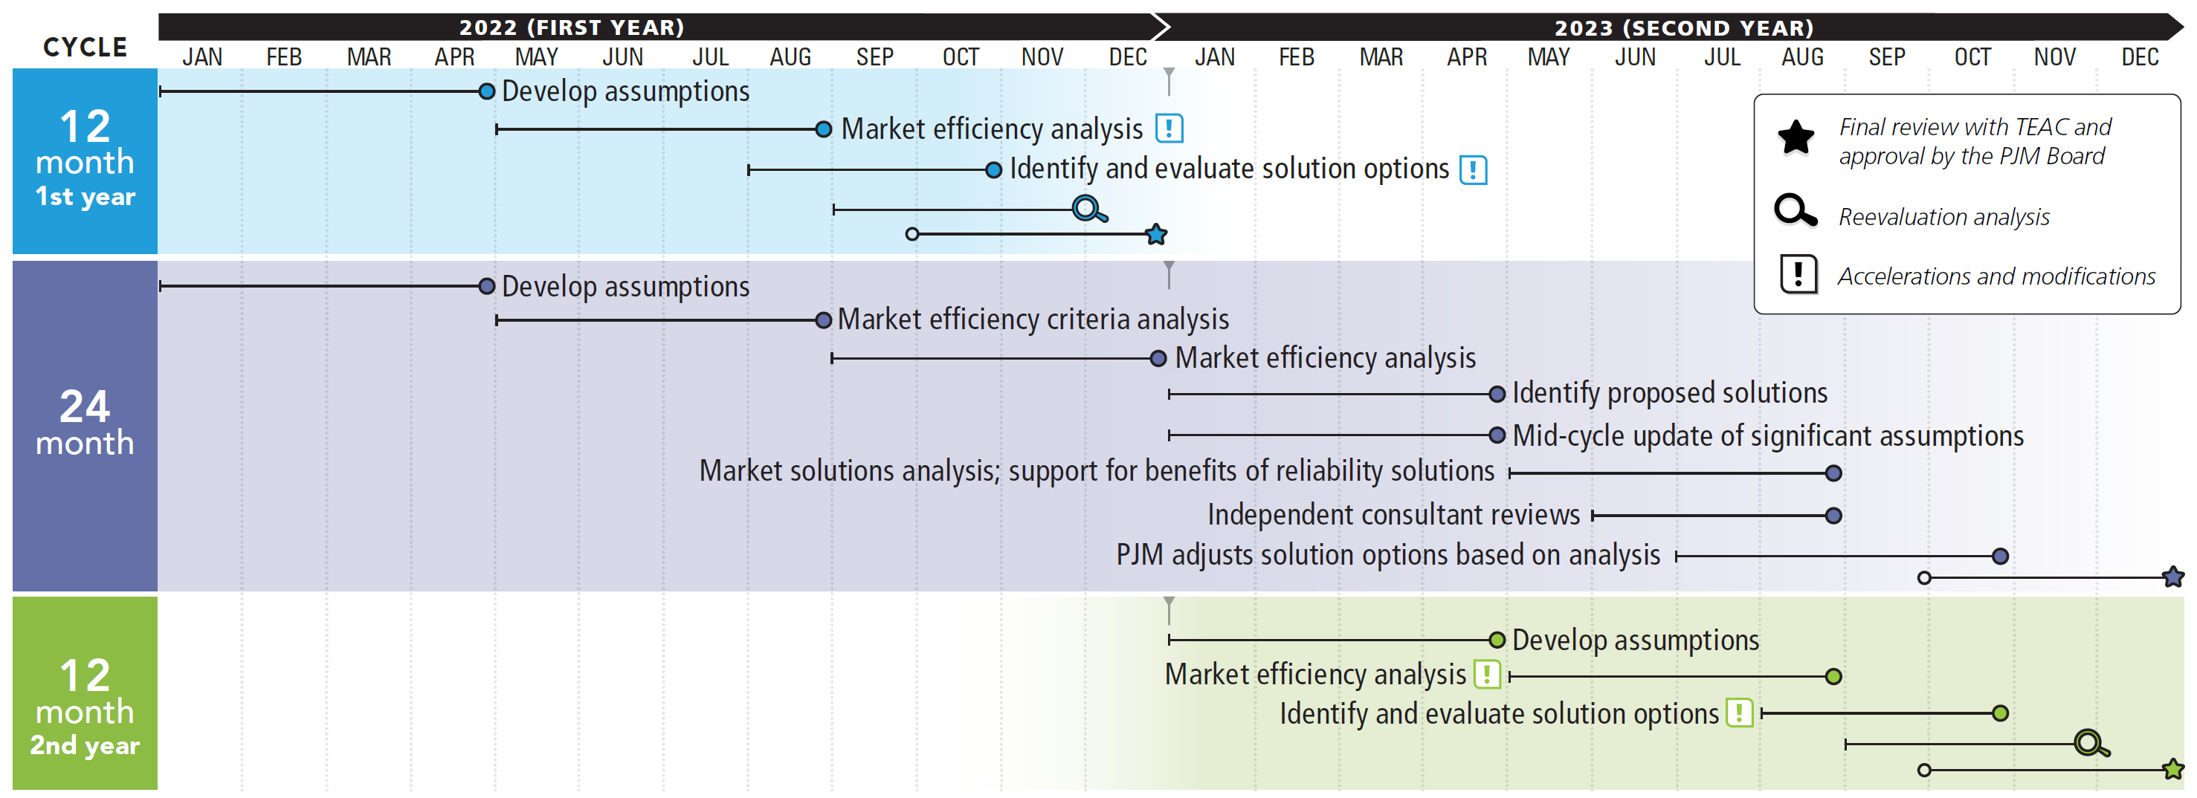
2022/2023 Market Efficiency 24-Month Cycle

Slide 24
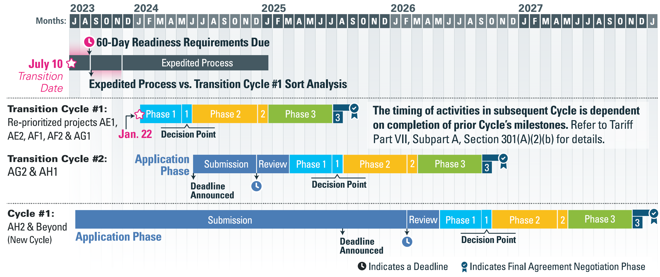
Interconnection Process Reform Timeline

Slide 25
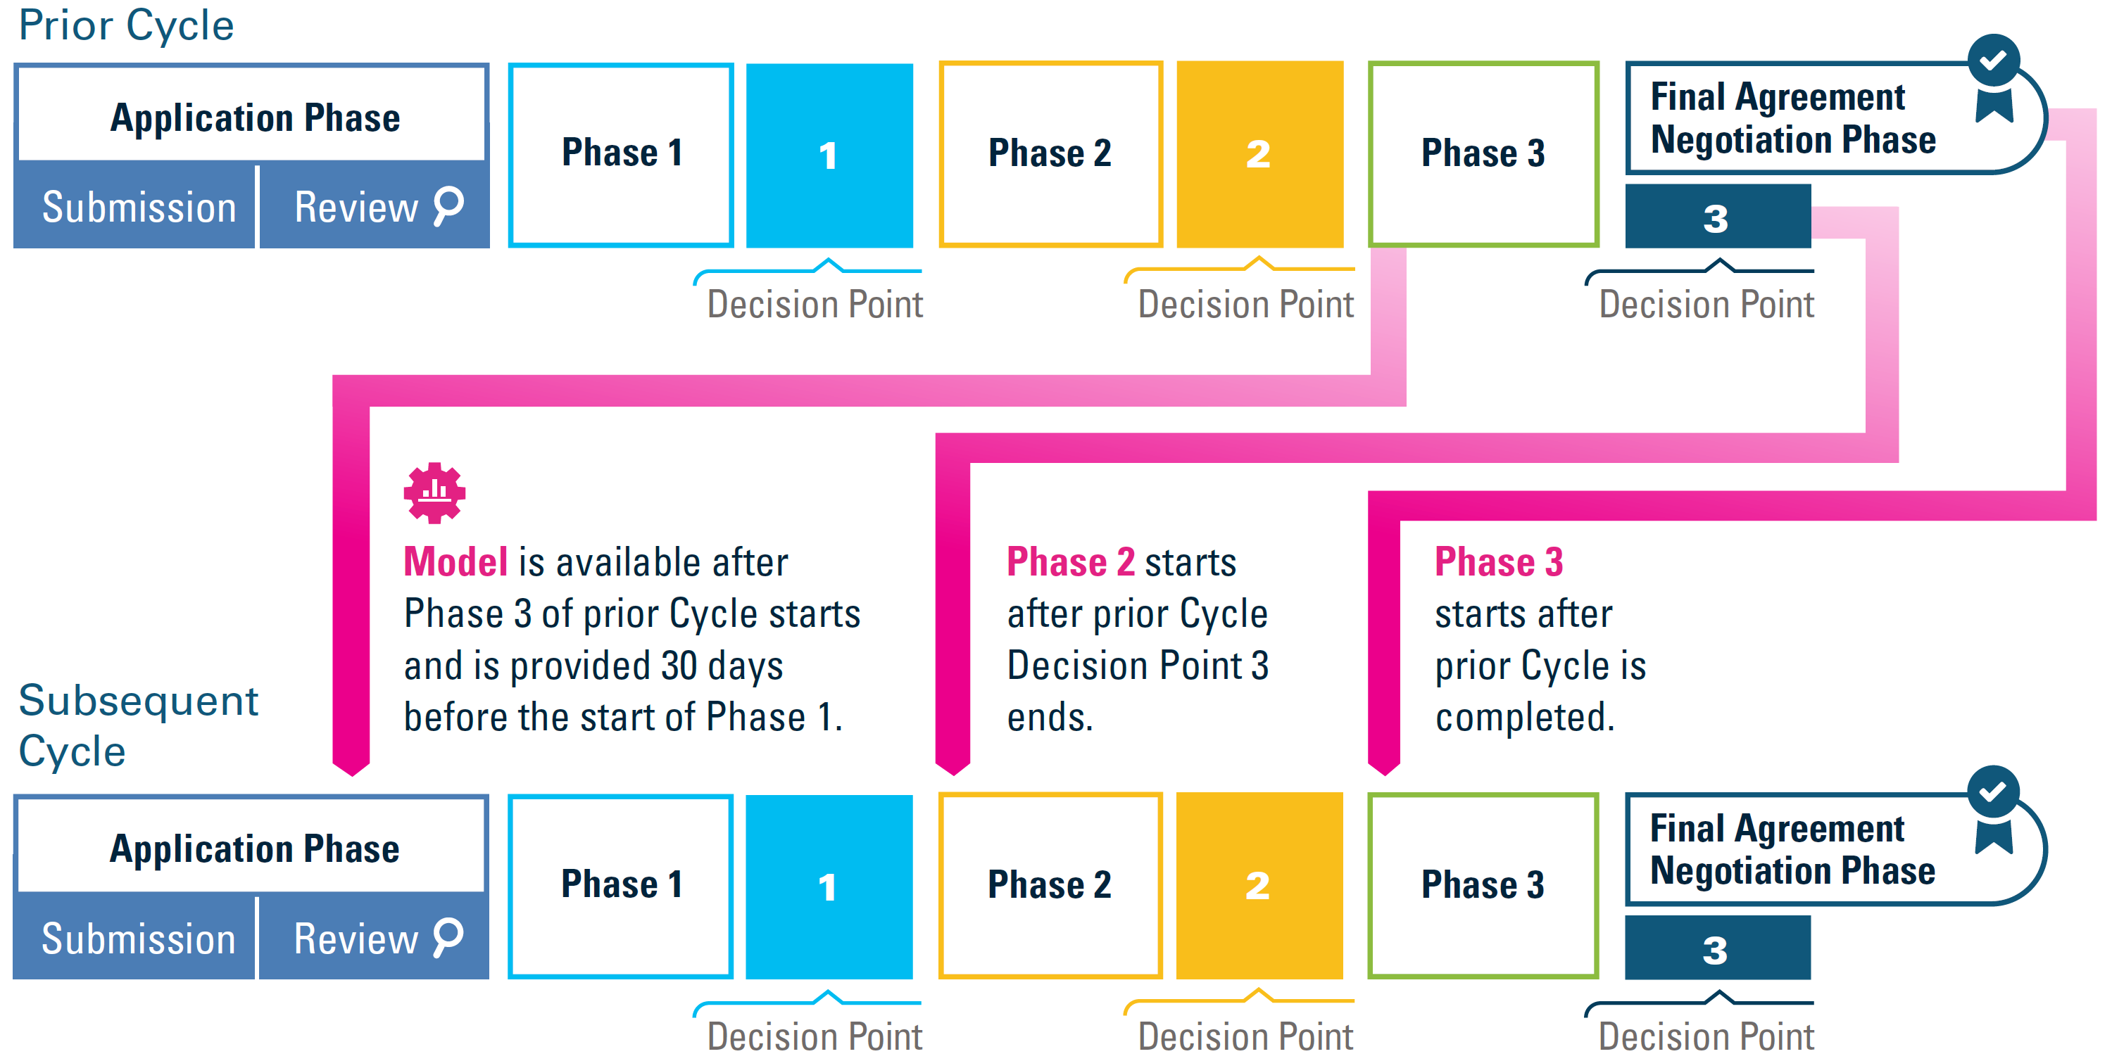
New Interconnection Request Cycles

